Slide 1


Introduction to Streaming
using

Slide 2
What is Streaming?
Data is generated continuously from one or many sources
Sources typically send in data simultaneously
Data comes in small packages (kilobyte scale) in succession

Slide 3
Why use Streaming?
A lot of applications use continuously-updated data
Examples:
Sensors in vehicles, industrial equipment, and machinery send data to streaming for performance measurement.
A website tracking geo-location data from customer’s phones, which is gathered by streaming, so the website can make recommendations of which restaurants to visit
Solar power company monitoring panel performance through streaming
Online gaming company collecting streaming data about player-game interactions
Notes:
reduceByKeyAndWindow(func, windowLength, slideInterval, [numTasks])
When called on a DStream of (K, V) pairs, returns a new DStream of (K, V) pairs where the values for each key are aggregated using the given reduce function func over batches in a sliding window. Note: By default, this uses Spark's default number of parallel tasks (2 for local mode, and in cluster mode the number is determined by the config property spark.default.parallelism) to do the grouping. You can pass an optional numTasks argument to set a different number of tasks
reduceByKeyAndWindow(func, invFunc, windowLength, slideInterval, [numTasks])
A more efficient version of the above reduceByKeyAndWindow() where the reduce value of each window is calculated incrementally using the reduce values of the previous window. This is done by reducing the new data that enters the sliding window, and “inverse reducing” the old data that leaves the window. An example would be that of “adding” and “subtracting” counts of keys as the window slides. However, it is applicable only to “invertible reduce functions”, that is, those reduce functions which have a corresponding “inverse reduce” function (taken as parameter invFunc). Like in reduceByKeyAndWindow, the number of reduce tasks is configurable through an optional argument. Note that checkpointing must be enabled for using this operation.

Slide 4
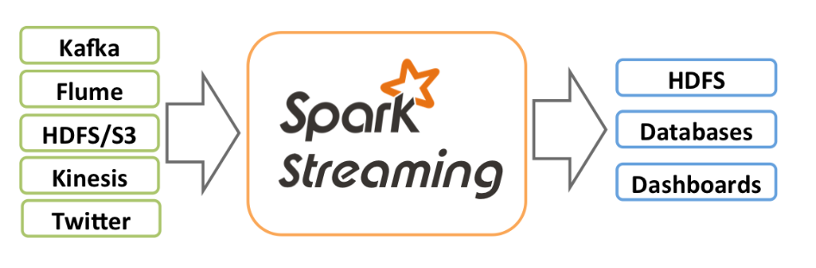
Spark Streaming
Spark Streaming enables scalable, high-throughput, fault-tolerant stream processing of live data streams.
Data can be ingested from many sources like Kafka, Kinesis, or TCP sockets,
Data can be processed using complex algorithms expressed with high-level functions like map, reduce, join and window
processed data can be pushed out to filesystems, databases, and live dashboards.
can apply Spark’s machine learning and graph processing algorithms on data streams.
Notes:
reduceByKeyAndWindow(func, windowLength, slideInterval, [numTasks])
When called on a DStream of (K, V) pairs, returns a new DStream of (K, V) pairs where the values for each key are aggregated using the given reduce function func over batches in a sliding window. Note: By default, this uses Spark's default number of parallel tasks (2 for local mode, and in cluster mode the number is determined by the config property spark.default.parallelism) to do the grouping. You can pass an optional numTasks argument to set a different number of tasks
reduceByKeyAndWindow(func, invFunc, windowLength, slideInterval, [numTasks])
A more efficient version of the above reduceByKeyAndWindow() where the reduce value of each window is calculated incrementally using the reduce values of the previous window. This is done by reducing the new data that enters the sliding window, and “inverse reducing” the old data that leaves the window. An example would be that of “adding” and “subtracting” counts of keys as the window slides. However, it is applicable only to “invertible reduce functions”, that is, those reduce functions which have a corresponding “inverse reduce” function (taken as parameter invFunc). Like in reduceByKeyAndWindow, the number of reduce tasks is configurable through an optional argument. Note that checkpointing must be enabled for using this operation.

Slide 5

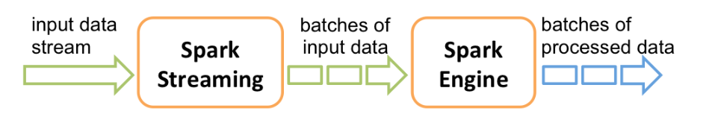
How Apache Spark Streaming works?
Spark Streaming receives live input data streams and divides the data into batches, which are then processed by the Spark engine to generate the final stream of results in batches.
Spark Streaming provides a high-level abstraction called discretized stream or DStream, which represents a continuous stream of data.

Slide 6















Apache Spark Structure
Programming Language API
Spark SQL
Spark Streaming
MLlib
GraphX
Spark Core
Data Source API

Slide 7


In-depth Example Application (finally)
Spark streaming allows for tracking frequently-updated datasets
Can use it to track most popular hashtags in 5 mins windows based on their counts in a Twitter stream, and by using the StreamingContext function.
Twitter HTTP
Client App

Slide 8
Structured Streaming
Structured Streaming is a scalable and fault-tolerant stream processing engine built on the Spark SQL engine.
The Spark SQL engine will take care of running it incrementally and continuously and updating the final result as streaming data continues to arrive
You can use the Data frame in Scala, Java, Python or R to express streaming aggregations, event-time windows, stream-to-batch joins, etc.
Structured Streaming queries are processed using a micro-batch processing engine, which processes data streams as a series of small batch jobs thereby achieving end-to-end latencies as low as 100 milliseconds
Spark 2.3, introduced a new low-latency processing mode called Continuous Processing, which can achieve end-to-end latencies as low as 1 millisecond

Slide 9
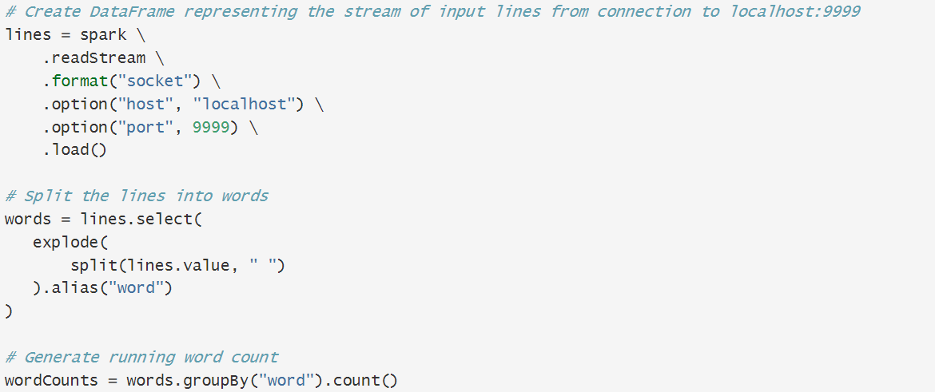
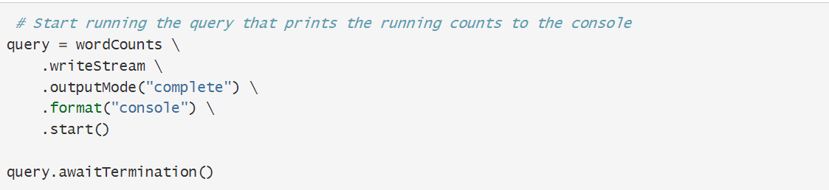

Slide 10
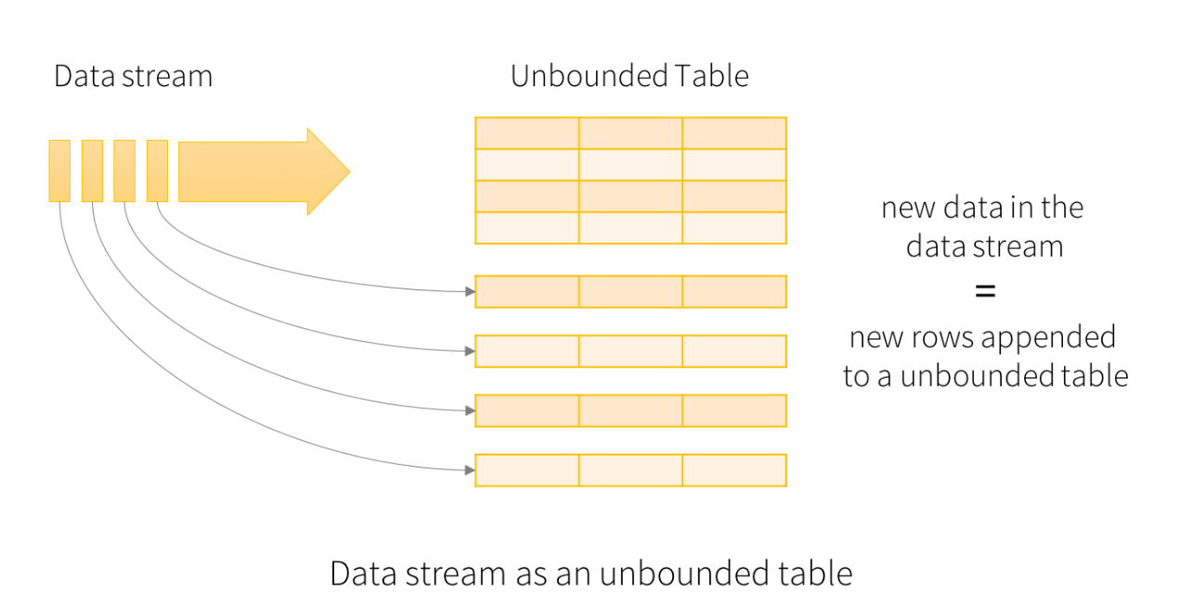
Programming Model
The key idea in Structured Streaming is to treat a live data stream as a table that is being continuously appended. This leads to a new stream processing model that is very similar to a batch processing model. You will express your streaming computation as standard batch-like query as on a static table
Basic Concepts
Consider the input data stream as the “Input Table”. Every data item that is arriving on the stream is like a new row being appended to the Input Table.

Slide 11
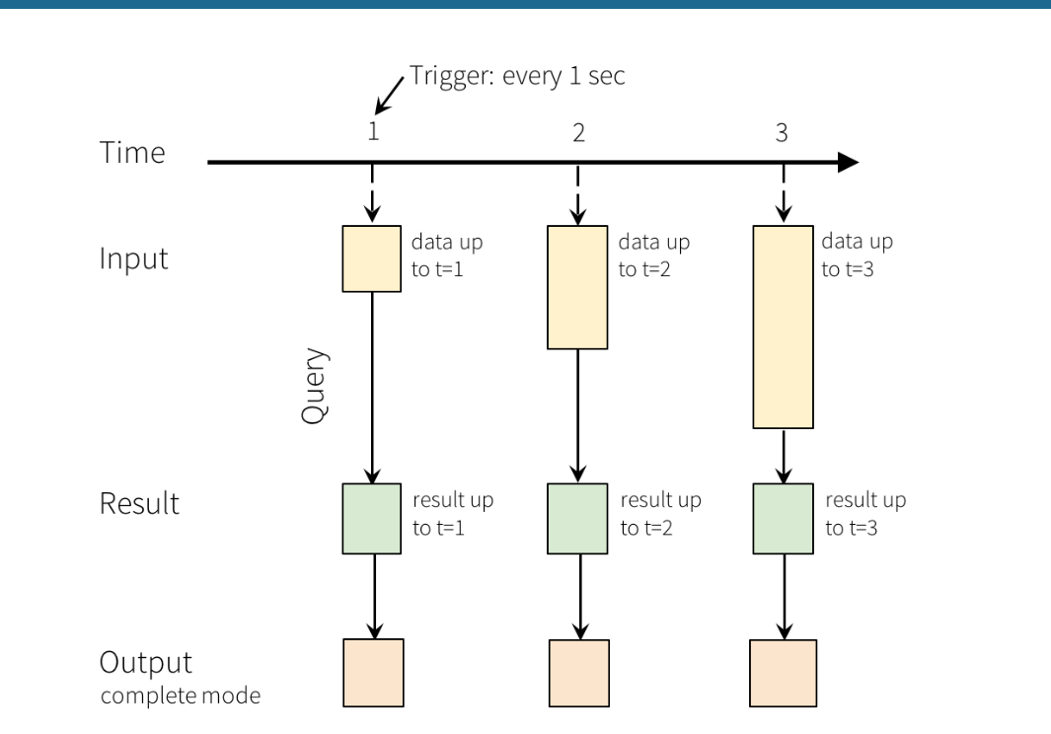
Programming Model
A query on the input will generate the “Result Table”. Every trigger interval (say, every 1 second), new rows get appended to the Input Table, which eventually updates the Result Table. Whenever the result table gets updated, we would want to write the changed result rows to an external sink.

Slide 12
Output Modes
The “Output” is defined as what gets written out to the external storage. The output can be defined in a different mode:
Complete Mode - The entire updated Result Table will be written to the external storage. It is up to the storage connector to decide how to handle writing of the entire table.
Append Mode - Only the new rows appended in the Result Table since the last trigger will be written to the external storage. This is applicable only on the queries where existing rows in the Result Table are not expected to change.
Update Mode - Only the rows that were updated in the Result Table since the last trigger will be written to the external storage (available since Spark 2.1.1). Note that this is different from the Complete Mode in that this mode only outputs the rows that have changed since the last trigger. If the query doesn’t contain aggregations, it will be equivalent to Append mode.
.

Slide 13
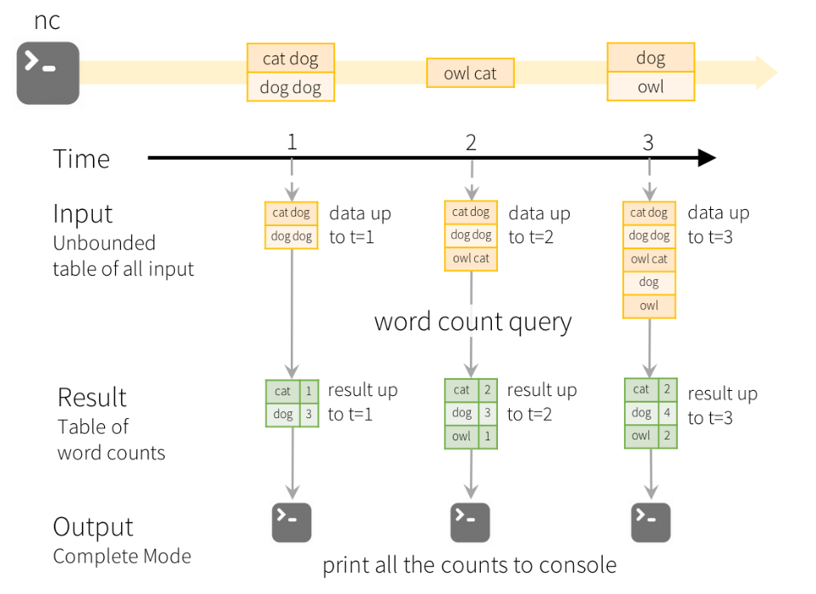
Structured Streaming
Structured Streaming is a scalable and fault-tolerant stream processing engine built on the Spark SQL engine.
The Spark SQL engine will take care of running it incrementally and continuously and updating the final result as streaming data continues to arrive
You can use the Data frame in Scala, Java, Python or R to express streaming aggregations, event-time windows, stream-to-batch joins, etc.
Structured Streaming queries are processed using a micro-batch processing engine, which processes data streams as a series of small batch jobs thereby achieving end-to-end latencies as low as 100 milliseconds
Spark 2.3, introduced a new low-latency processing mode called Continuous Processing, which can achieve end-to-end latencies as low as 1 millisecond

